Slide 1




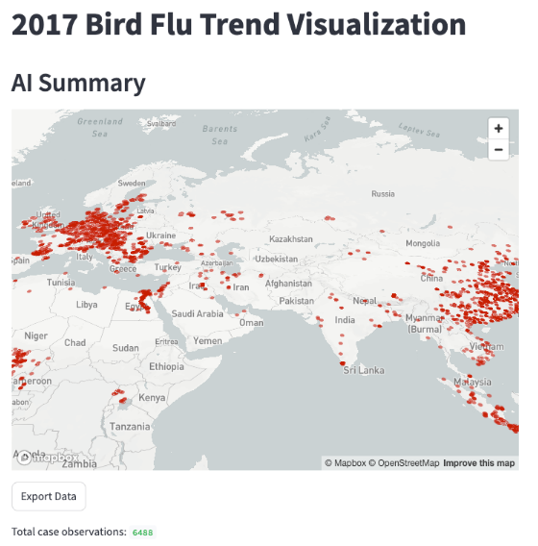
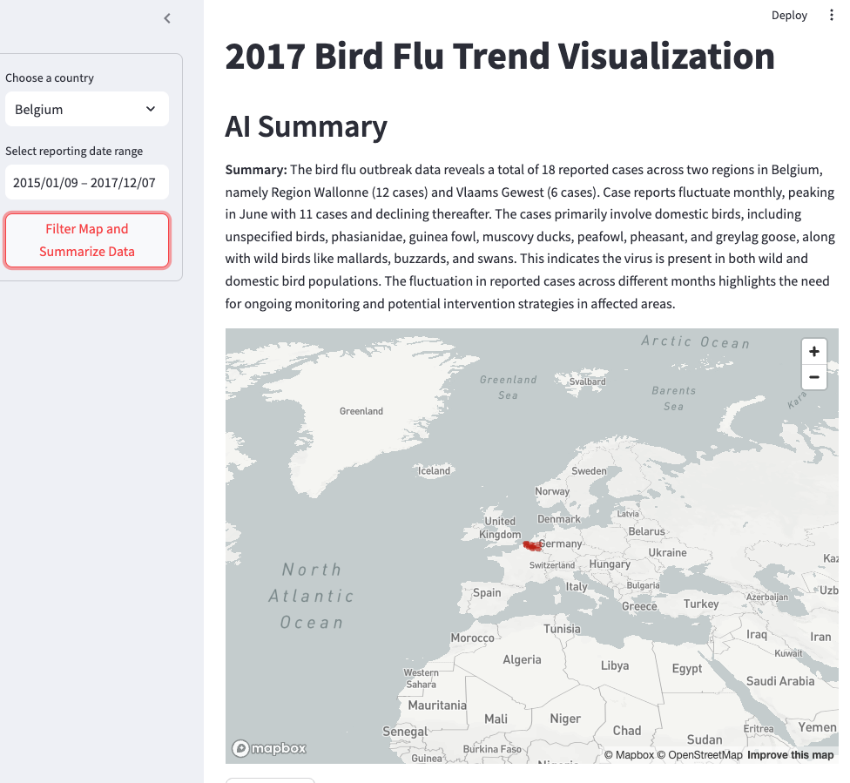
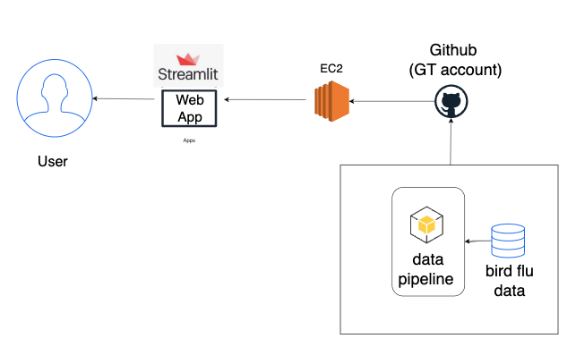
2017 Bird Flu Transmission Path Research
App Link
Research conducted by [Yijun Chen, Yushi Ding]
INTRODUCTION
Design
CONCLUSION
A recent outbreak in bird flu resulted in the mass death of chickens, which in turn caused a sharp rise in egg prices and underscored the extensive economic and societal impacts of infectious diseases.
Given the highly infectious nature of bird flu and its global impact, we aim to develop an application that allows researchers to track the disease's progression during an outbreak and identify patterns in its spread across the world. In response to these challenges, our project will develop a dynamic, interactive application leveraging bird flu observation data from 2017.
An avian flu outbreak and increasing costs of fuel, feed and packaging have contributed to an egg supply shortage and high prices in some parts of the country.
Infected or exposed flocks are culled to prevent the virus from spreading, a measure that has resulted in the depopulation more laying hens around the world.
Review case patterns
Limitation
Future Study
Data limitations:
One of the biggest challenges was the availability of reliable data that could be ingested into our application. Future work could benefit from integrating more reliable sources, collaborating with public health databases, or even building a system to crowdsource and validate data.
Lack of Multi-Modal Data Fusion:
The current framework focuses primarily on epidemiological data. The absence of economic indicators like the egg price index means that important dimensions of the outbreak’s impact on supply chains and market dynamics remain unexplored.
Prediction features:
The app could be enhanced with predictive modeling (e.g., using machine learning to project future outbreaks), better filtering options, and alert systems for emerging patterns. Adding genomic data or linking to ecological factors like migratory bird paths would also enrich analysis.
DESIGN
This Python-based single-page application was developed to serve as a tool for researchers by offering a comprehensive, interactive view of an outbreak progression. We deployed the application on an AWS EC2 instance to ensure high availability, scalability, and easy access for users.
We integrated a timeline slider and country filter to allow users to visualize transmission trends and pinpoint outbreak patterns by filtering cases by date and location, while a large language model generated tailored AI summaries of new case data to enhance insight extraction.
Filter case and review AI case summary

